Slide 1
SDSE Lab 3
K Means Clustering

Slide 2
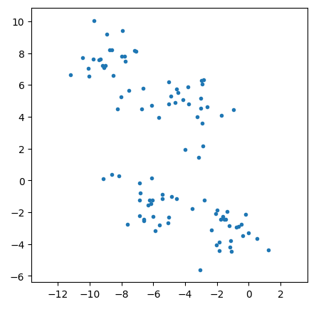
K-Means Clustering Algorithm
Unsupervised Learning
No data labels
Goal to cluster data into meaningful groups

Slide 3
K-Means Clustering Algorithm
Step 0: randomly initialize centroids
Alternate between
Assigning datapoints to a cluster based on closest centroid
Re-calculating the centroids as the mean of each cluster

Slide 4
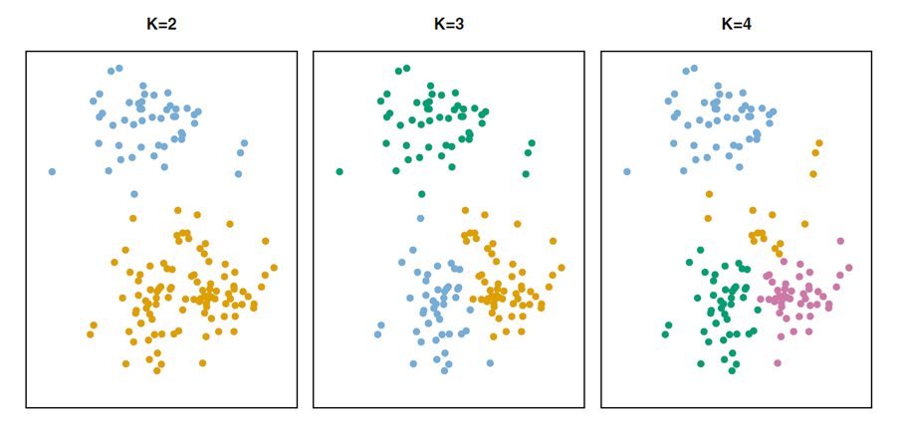
Extensions
How to select number of clusters, K?
How does initial position of centroids affect the solution?

Slide 5
Logistics
Lab 2 is due Sunday Oct 1 (10/1) at 11:59PM
Lab 3 is due Sunday Oct 15 at 11:59PM
Export:
IMPORTANT: Kernel>Restart&Run All
Make sure you pass everything
Save using File>Save
Run the last cell, which generates a .zip file in the same folder as your lab
Upload this .zip to Gradescope
One assignment per group
After submitting, select group members in gradescope
Eventually, the auto-grader will tell you in gradescope your score
Submit early so you can troubleshoot

